Slide 1
Welcome to CS4222 PSLG!
With Robert and Jakub

Slide 2
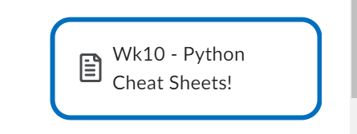
DLSH
DLSH has uploaded Python “cheat sheets” which you can use as a quick reference when you are studying the Python language
The “cheat sheets” can be found under content > ICT Learning Centre > CS4222 – Software Dev > Week10

Slide 3
Problem 1
Write a Python method to reverse a string using a loop (Keyword : Method)

Slide 4
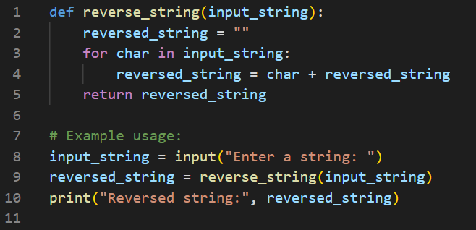
Answer:

Slide 5
Problem 2
Write a Python program to check if a given integer is in a list and add the integer if it’s not in the list

Slide 6
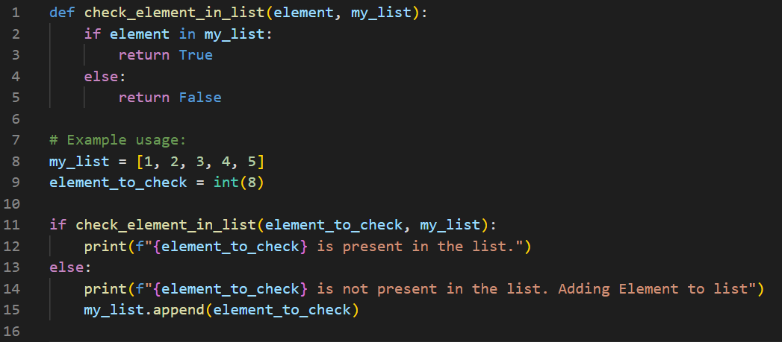
Answer:

Slide 7
Problem 3
Create a Python class called “car” with the following attributes “make, model, year, colour” and with the followings methods “__innit__” and “display_info” (“__innit__” is the initialisation method)

Slide 8
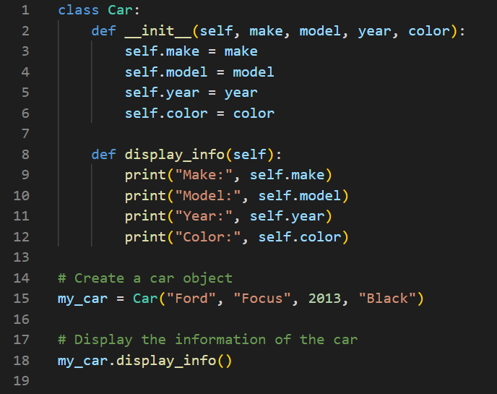
Answer:

Slide 9

Thank you for coming!

